Slide 1
Volunteer Management, Recruitment and Engagement
Michael C. Mayse, MNO

Slide 2
agenda
Introductions
Board Responsibilities
Board Truths
How to Start
Questions
Next Steps

Slide 3
Michael Mayse
40 years experience in the nonprofit sector:
Recruiting and training top corporate leaders as directors.
Creating multi-level development campaigns including special events and grant writing.
Strategic planning and interim management.
Current project: monthly “New Normal” Zoom roundtable with 10 executive directors to discuss how COVID-19 has changed the nonprofit community in Chicago.
Clients:
IMD Guest House
Aspiritech
Goldie’s Place
Chicago Veterans Coordinating Committee
Copernicus Center
Chicago Furniture Bank
Pet Partners
American Board of Dental Implantology
Master’s degree in Nonprofit Management (MNO) from Weatherhead School of Business.
Michael Mayse Consulting
Michael.Mayse@gmail.com
www.mayseconsulting.com

Slide 4
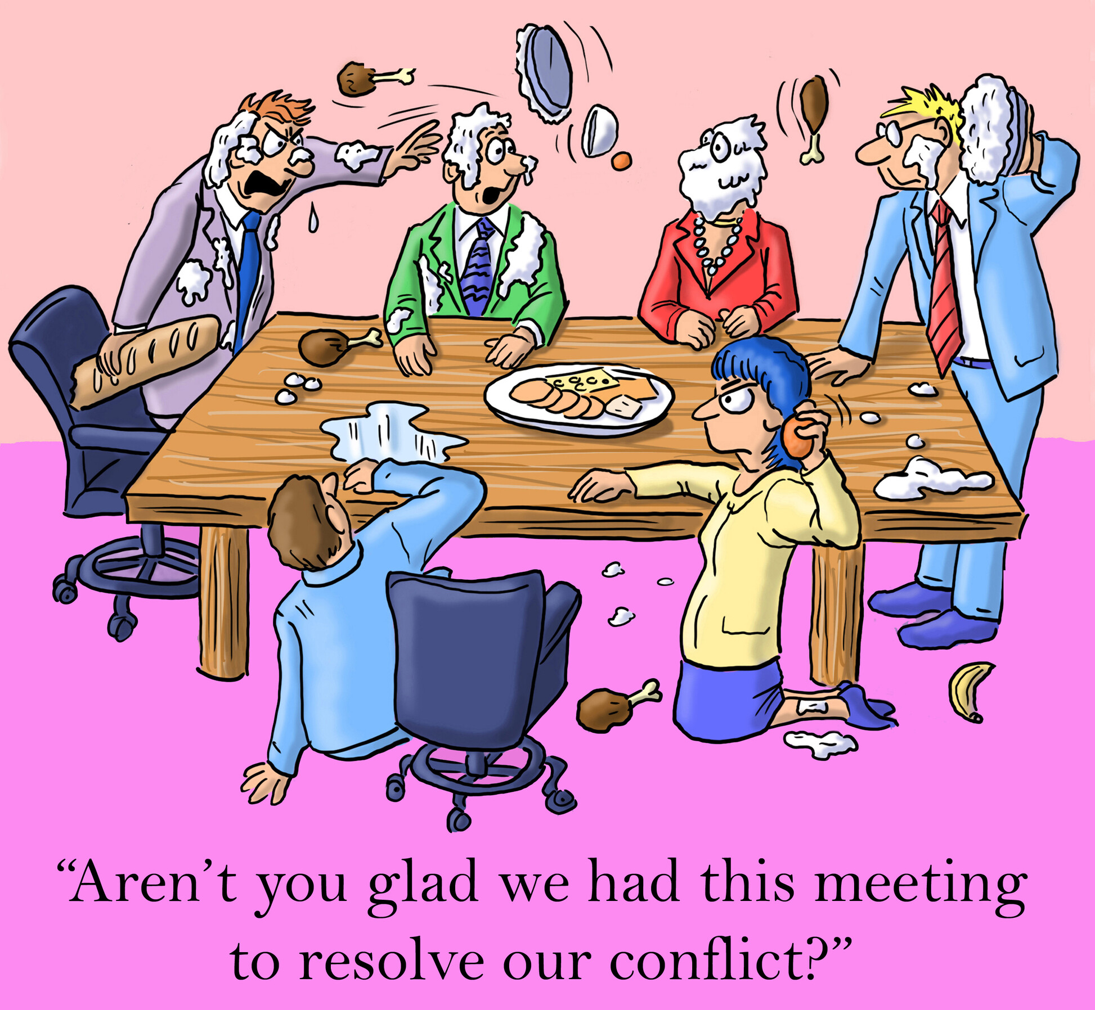

Slide 5
Board responsibilities
Establish policy, oversee conduct of the chapter.
Each Board member should be:
An active ambassador for IABC who understands and interprets its work to the community.
In attendance at all regularly scheduled meetings.
Willing to participate actively in at least one board standing committee.
An active supporter of Chapter events or programming.
Prepared for each Board meeting by studying all appropriate reports and being prepared to discuss current activities of committees to which they are assigned.
Willing to assist in recruiting prospective new volunteers, board members and potential sponsors.
A member who performs none of these would not be asked to continue serving.

Slide 7
Board truths
One third are learning,
One third are doing,
One third are talking about what they did last year.

Slide 9
10 board challenges
Challenges
Solutions
Board members don't understand their responsibilities.
Deliver an effective board orientation; provide access to a leadership manual or password-protected board portal.
The board simply isn’t engaged.
When board members lose attention, be sure the work, agendas and discussions focus on the mission and goals. The strategic direction should be clear and compelling to engage volunteers.
Some board members don’t show up.
Follow the bylaws and promote fiduciary responsibility, especially duty of care. Board members attend officially called meetings to fulfill their roles.
The board prefers to manage, not govern.
The purpose of a board is governance. Management is a duty of staff.
www.nonprofitcenter.com bob@rchcae.com Bob Harris, CAE

Slide 10
10 board challenges
Challenges
Solutions
Fiduciary duties are not
understood by the board.
The fiduciary duties include care, obedience, and loyalty. Board members should understand their implications.
Board members lack financial understanding.
If board members don’t understand finances, reports and audits, bring in a CPA or trainer. Protecting the resources is a board duty.
Some board members have personal agendas.
Board members should work to advance the mission and the strategic plan. It’s not about the personal agenda of officers or directors. Require disclosure of conflicts of interest.
We have the same board members we had 10 years ago!
Organizations enact term limits to bring on new board members, limiting the number of years or terms.
www.nonprofitcenter.com bob@rchcae.com Bob Harris, CAE

Slide 11
10 board challenges
Challenges
Solutions
Some board members are never prepared.
Stress the importance of “read to lead.” Board members should prepare for meetings and ask questions in advance (duty of care/due diligence.)
We have board members who seem to be incompetent in their board service.
Selection of board members should be based on competency --- not geography, who knows who, or being “out of the room when board members were selected.” Provide training, information, and resources. Identify the desired core competencies for the board before the nominating process.
www.nonprofitcenter.com bob@rchcae.com Bob Harris, CAE

